Slide 1
Predicting Annual Income of Individual using Classification Techniques
2023S-AAI - 695-WS2
Team 6
Date: 05/10/2023

Slide 2
Team members
Darsh Patel(20012159)
Janmejay Mohanty(20009315)
Soumen Sikder Shuvo(20011273)

Slide 3
Flow of presentation:
Introduction
Dataset description
Feature engineering
Implementation of ML algorithms
Comparision and conclusion
Future work
Reference

Slide 4
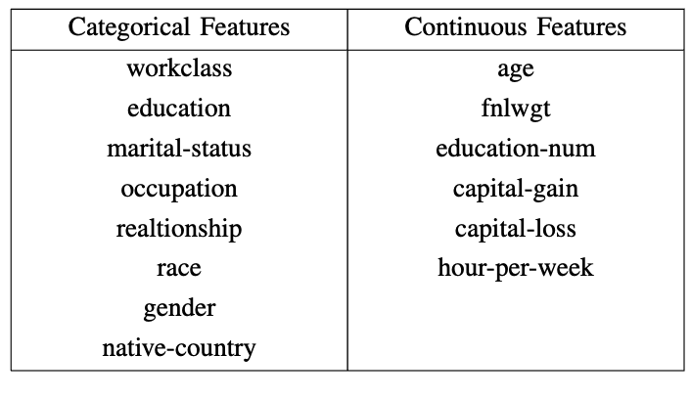
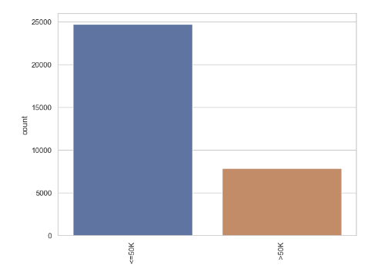
Dataset description and task
Adult dataset
https://archive.ics.uci.edu/ml/datasets/adult
1994 United States census data
48842 rows * 15 columns
8 Categorical features and 6 continuous features
Task
Our Task is to determine whether a person makes our $50k given the attributes

Slide 5
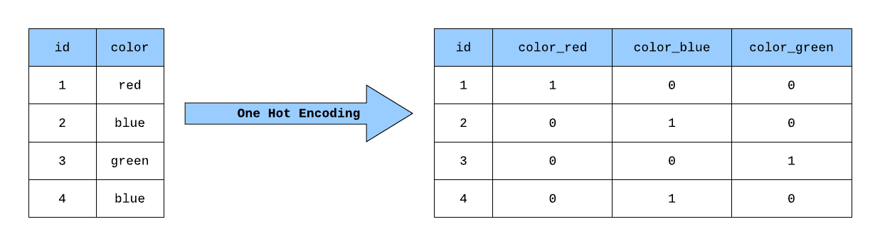
Feature Engineering
Feature Engineering is not any ML Algorithm, rather than it is a data processing technique, where we use these processed data to train established ML models.
Used to extract important features
Can reduce the error due to imbalanced dataset
Can be computationally Expensive
There are many Feature Engineering Techniques:
Imputation.
Discretization.
Categorical Encoding.
Feature Splitting.
Handling Outliers.
Variable Transformations.
Creating Features.

Slide 6
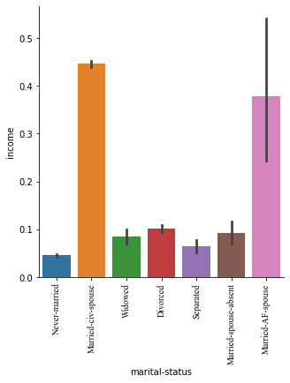
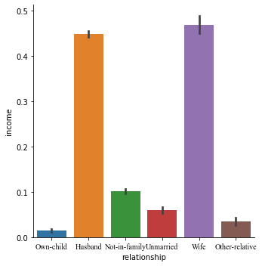
Feature Engineering
Categorical Encoding: Used to encode categorical features into numerical values which are usually simpler for an Machine Learning algorithm.
We used One-hot Encoding as Feature Engineering Method. Then used that data in Decision Tree and Random Forest to perform the Classification.
Discretization: Takes a set of values of data and groups the sets of them together in some logical criteria.
Here we can see some values have very high probability of earning more than 50k, and others have very less. We can merge them to make new features.

Slide 7
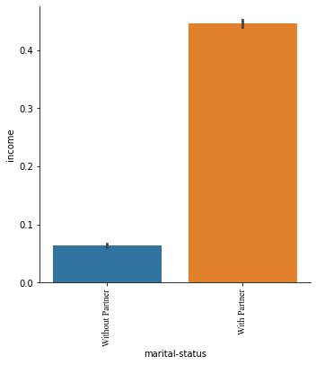
Feature Engineering

Slide 8

Decision Tree
Here, the data is recursively split into subsets based on the most informative features for predicting the target variable.
Robust algorithm for binary classification tasks
Better for Complex Feature Structures
Can Handle Both Categorical and Continuous Data
Have the tendency to overfit training data
We used various parameters and got best results at,
max_depth = 9,
min_samples_leaf = 4,
min_samples_split = 2
Accuracy = 85.6%
F-1 Score = 0.687

Slide 9
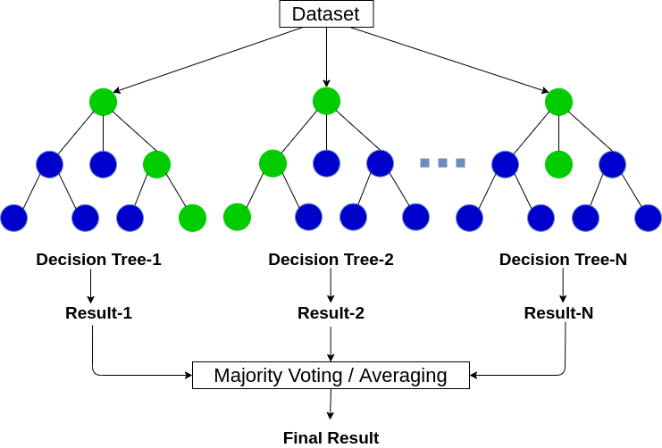
Random Forest
Random Forest is a supervised algorithm that uses ensemble learning method consisting of a multitude of decision trees.
Each tree in a random forest is trained on a random subset of the training data
Can automatically identify important features in the data
Can handle both categorical and continuous data
Has a lower risk of overfitting compared to a single decision tree
We used Grid Search algorithm of Scikit-learn to search for the best parameters. At, n_estimators = 300 and max_features = 6, we get the best result.
Accuracy = 85.59%
F-1 Score = 0.688

Slide 10

SVM
Support Vector Machine is a supervised learning algorithm that works by finding a hyperplane in a high- dimensional space that best separates the data into different classes.
Effective with more features
Highly dependent on Hyperparameters , such as kernel function
Computationally Expensive
We used SVM using linear and rbf kernels. The accuracy and
F-1 score in SVM was not good. The probable reason can be
the features are more overlapping and hugely unbalanced
Dataset.

Slide 11
Feature Engineering
Feature Engineering is not any ML Algorithm, rather than it is a data processing technique, where we use these processed data to train established ML models.
Used to extract important features
Can reduce the error due to imbalanced dataset
Can be computationally Expensive
There are many Feature Engineering Techniques:
Imputation.
Discretization.
Categorical Encoding.
Feature Splitting.
Handling Outliers.
Variable Transformations.
Creating Features.

Slide 12
Feature Engineering
Categorical Encoding: Used to encode categorical features into numerical values which are usually simpler for an Machine Learning algorithm.
We used One-hot Encoding as Feature Engineering Method. Then used that data in Decision Tree and Random Forest to perform the Classification.
Discretization: Takes a set of values of data and groups the sets of them together in some logical criteria.
Here we can see some values have very high probability of earning more than 50k, an others
Have very less. We can merge them to make new features.

Slide 13
Feature Engineering

Slide 14
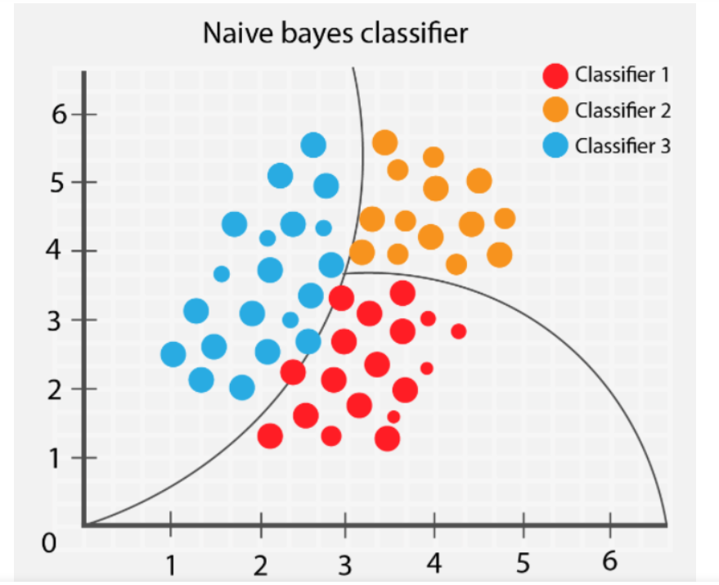
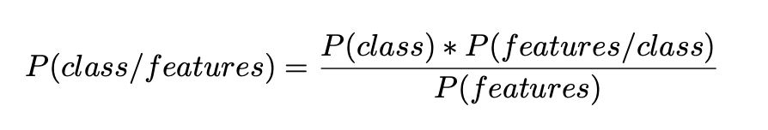

Naive Bayes Algorithm
What is Naïve bayes algorithm?
Probabilistic machine learning algorithm
It calculates the probability of a data point belonging to a certain class by assuming the independence between its features.
It uses bayes theorem

Slide 15
Implementation and results
Divided our training data into 80-20 split
80% training and 20% testing
GaussianNB()
Accuracy : 79.9%
Precision: 64.95 %
Recall: 31 %
F1 score: 41.97 %

Slide 16
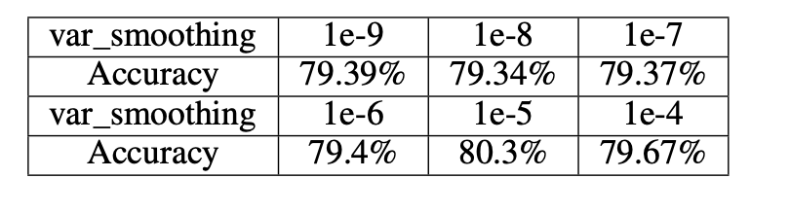
Hyperparameter Tunning
Grid Search
Var smoothing: [1e-9, 1e-8, 1e-7, 1e-6, 1e-5, 1e-4, 1e-3]
CV = 5
Total fit= 7*5 = 35 fits
Best performance
Var smoothing = 1e-5
Accuracy : 80.3%
Precision: 72.54 %
Recall: 30.34 %
F1 score: 42.8 %

Slide 17
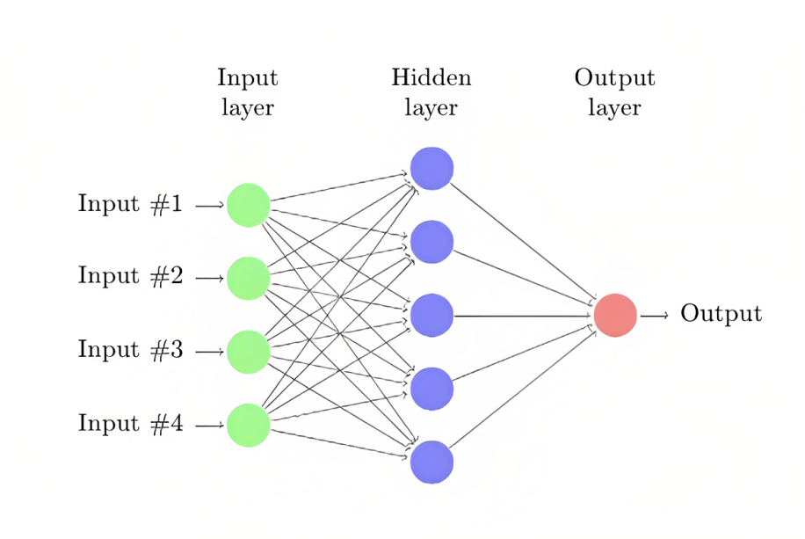
Artificial neural network
What is ANN?
It is a computational model that mimics the way nerve cells work in the human brain
Architecture of ANN
Input Layer
Output Layer
Hidden Layer
Neurons
Weights
Biases

Slide 18
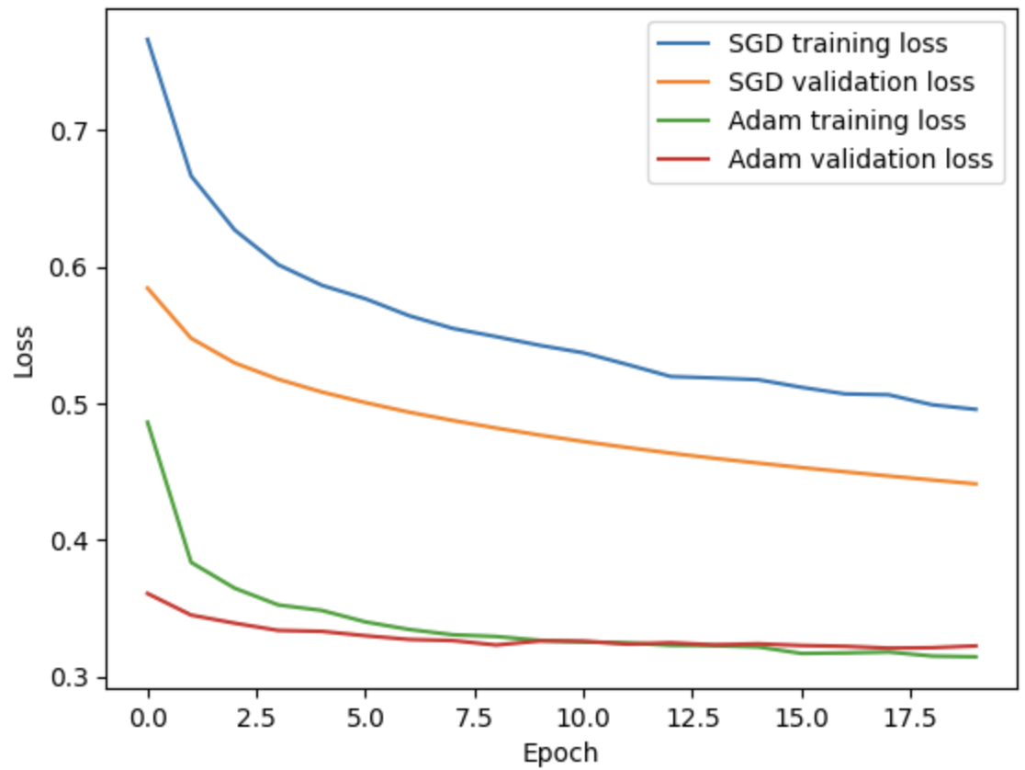
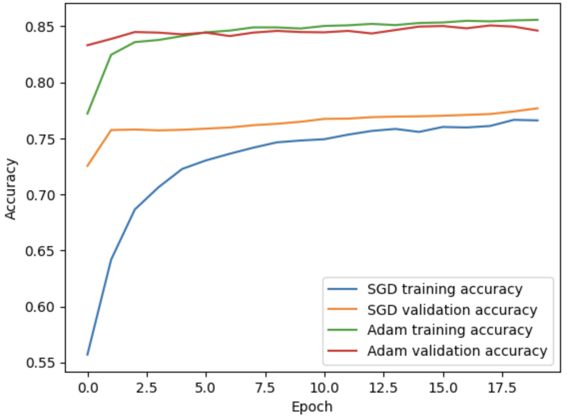
Our model Architecture and training parameters
Input layer: neurons = 64, activation = Relu
Dropout = 0.5
Hidden layer : neurons = 32, activation = Relu
Dropout = 0.5
Output layer: neurons=1, activation = sigmoid
Optimizers used are Adam and Stochastic Gradient Descent
Learning rate = 0.01
Loss = Binary cross entropy
Epochs = 20
Batch size = 128
Validation split = 0.1

Slide 19
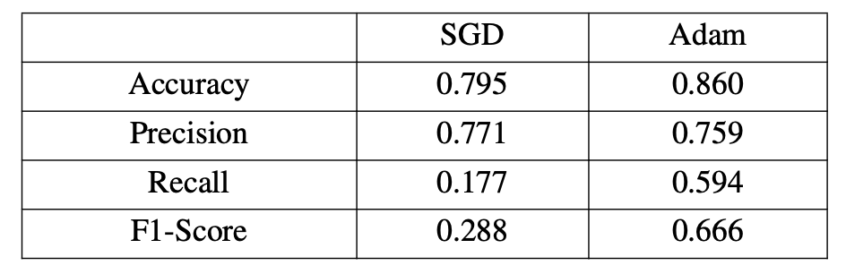
Evaluation matrix
Key Things to Notice:
Accuracy of Adam optimizer is more
Precision of SGD optimizer is more but not significantly more
Recall of Adam optimizer is more than that of SGD
F1 score of Adam optimizer is more
Bad F1 and Recall score shows that SGD optimizer is not good for our model

Slide 20
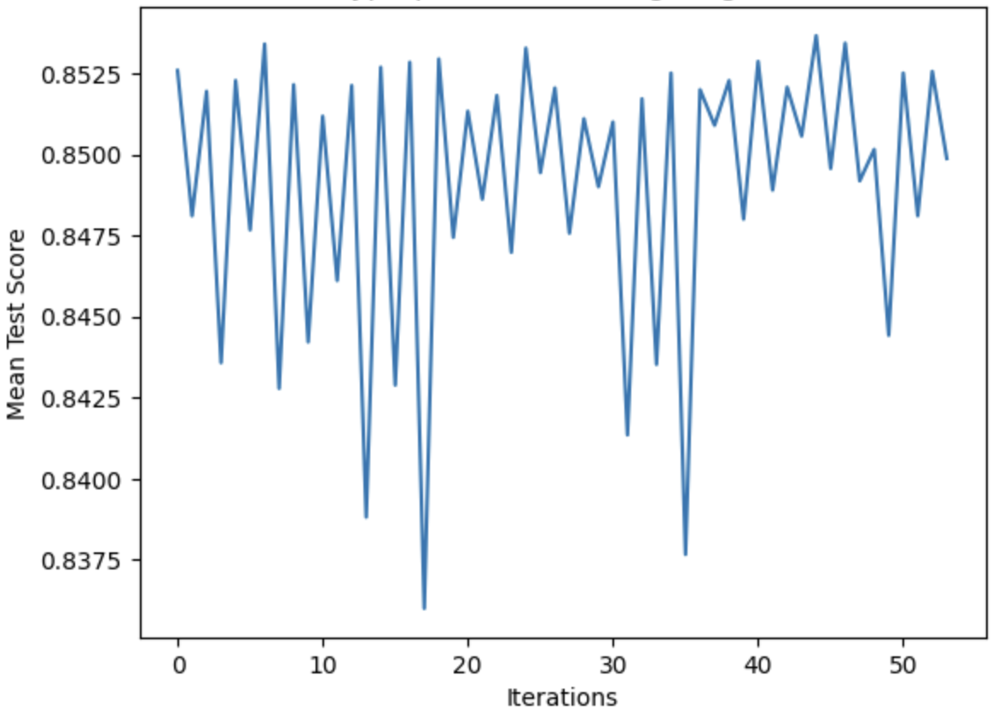
Hyper Parameter tunning
GridSearch
Batch Size: 32, 64, 128
Epochs: 10, 20, 30
Optimizer: Adam(Learning rate=0.001), Adam(Learning rate= 0.01)
Dropout rate: 0.2, 0.3, 0.5
CV = 3
Total fit = 3 * 3 * 2 * 3 * 3 = 162 fits
Best Test score : batch size = 128, Dropout = 0.3, epochs 20, learning rate = 0.001

Slide 21
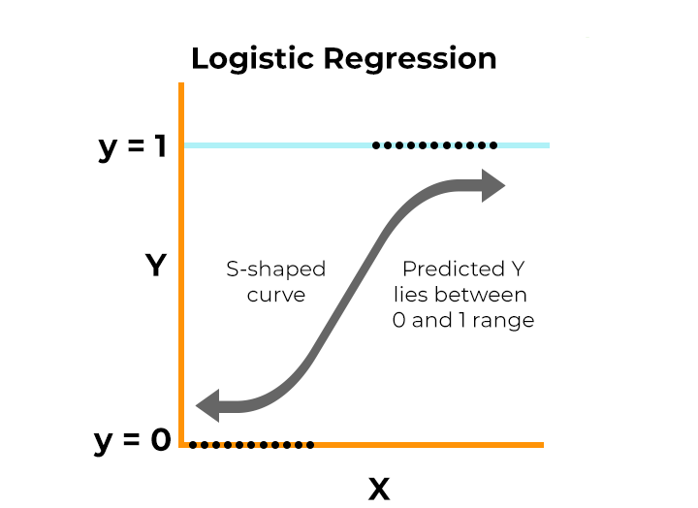

Logistic Regression
The logistic model is a statistical model that models the probability of an event taking place by having the log-odds for the event be a linear combination of one or more independent variables
Logistic regression estimates the parameters of a logistic model
General Logistic Regression expression:
Logistic Regression helps us to identify the data anomalies

Slide 22

Results Of Hyperparameter Logistic Regression
Performed Hyperparameter tuning
Regularization -> 'L1'
Optimizer -> 'liblinear'
Inverse Regularization Strength -> '10'
Accuracy Rate -> 83%

Slide 23
Comparing Logistic Regression Results Between Hyperparameter and Without Hyperparameter
 | Confusion Matrix Without Hyperparameter Tuning
True | True | 4673 | 269
 | False | 1102 | 469
 |  | True | False
 | Predicted
 | Confusion Matrix With Hyperparameter Tuning
True | True | 4668 | 274
 | False | 862 | 709
 |  | True | False
 | Predicted
Classification Report Without Hyperparameter Tuning
 | Precision | Recall | F1-Score | Support
0 | 0.81 | 0.95 | 0.87 | 4942
1 | 0.64 | 0.30 | 0.41 | 1571
Accuracy |  |  | 0.79 | 6513
Macro Avg | 0.72 | 0.62 | 0.64 | 6513
Weighted Avg | 0.77 | 0.79 | 0.76 | 6513
Classification Report With Hyperparameter Tuning​
​ | Precision​ | Recall​ | F1-Score​ | Support​
0​ | 0.84 | 0.94 | 0.89​ | 4942​
1​ | 0.72​ | 0.45 | 0.56​ | 1571​
Accuracy​ | ​ | ​ | 0.83​ | 6513​
Macro Avg​ | 0.78 | 0.70​ | 0.72 | 6513​
Weighted Avg​ | 0.81 | 0.83​ | 0.81 | 6513​

Slide 24
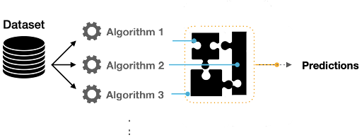
Ensemble Modeling
Ensemble modelling is a technique in which various multiple models are created to predict an outcome, either by using various modeling algorithms or using different training datasets.
In this project we are using different modeling algorithms approach.
We have use three different algorithms for ensemble modeling which are listed below:
Decision Tree
Random Forest
Logistic Regression
We have use Vote Classifier for performing Ensemble modeling.

Slide 25
Advantages of Ensemble Modeling
There are two main advantages of ensemble modeling
Performance
Robustness
It help us making better predictions and achieve better performance than any single running model
It reducing the spread or dispersion of the predictions and model performance

Slide 26
Results of Hyperparameter Ensemble Modeling
Performed Hyperparameter tuning
Decision Tree -> max depth '10'
Logistic Regression -> inverse regularization strength '1.0'
Random Forest -> estimator '200'
Accuracy Rate -> 86%

Slide 27
Comparing Ensemble Model Results Between Hyperparameter and Without Hyperparameter
 | Confusion Matrix Without Hyperparameter Tuning
True | True | 4627 | 315
 | False | 662 | 909
 |  | True | False
 | Predicted
 | Confusion Matrix With Hyperparameter Tuning
True | True | 4716 | 226
 | False | 687 | 884
 |  | True | False
 | Predicted
Classification Report Without Hyperparameter Tuning
 | Precision | Recall | F1-Score | Support
0 | 0.87 | 0.94 | 0.90 | 4942
1 | 0.74 | 0.58 | 0.65 | 1571
Accuracy |  |  | 0.85 | 6513
Macro Avg | 0.81 | 0.76 | 0.78 | 6513
Weighted Avg | 0.84 | 0.85 | 0.84 | 6513
Classification Report With Hyperparameter Tuning​
​ | Precision​ | Recall​ | F1-Score​ | Support​
0​ | 0.87​ | 0.95​ | 0.91​ | 4942​
1​ | 0.80​ | 0.56​ | 0.66​ | 1571​
Accuracy​ | ​ | ​ | 0.86​ | 6513​
Macro Avg​ | 0.83​ | 0.76​ | 0.79 | 6513​
Weighted Avg​ | 0.85 | 0.86​ | 0.85 | 6513​

Slide 28
Comparison
ML Algorithm Used | Accuracy | F1-Score
Decision Tree | 85.60% | 67.54%
Random Forest | 85.59% | 67.86%
SVM | 79.71% | 63.68%
ANN with ADAM | 86.10% | 66.60%
ANN with SGD | 78.40% | 28.80%
Naive Bayes | 80.30% | 42.8%
Logistic Regression | 82.60% | 55.52%
Ensemble Learning | 85.98% | 65.94%
Decision Tree with Feature Engineering | 85.77 | 66.56%
Random Forest with Feature Engineering | 85.73 | 67.84%

Slide 29
Future Potentials
Imbalanced Data Handling
Explainable AI
Additional Data Sources

Slide 30
References
S. Deepajothi and S. Selvarajan, “A comparative study of classification techniques on adult data set,” International Journal of Engineering Research & Technology (IJERT), vol. 1, no. 8, 2012.
R. Sabitha and S. Karthik, “Performance assessment of feature selection methods using k-means on adult dataset,” CCIIT, vol. 4, pp. 606–612, 2013.
N. Chakrabarty and S. Biswas, “A statistical approach to adult census income level prediction,” in 2018 International Conference on Advances in Computing, Communication Control and Networking (ICACCCN). IEEE, 2018, pp. 207–212.

